Slide 1
Lecture 4: Measure of Dispersion & Normal Curve
Jibo He, Ph.D.
Associate Professor
Wichita State University
jibo.he@Wichita.edu

Slide 2
Summary on Central Tendency Measure
The most common method for summarizing and describing a distribution is to find a single value that defines the typical value taken by the scores and can serve as a representative for the entire distribution.
This representative score is called the central tendency
The goal of central tendency is to find the single score that is most typical or most representative of the entire group

Slide 3
Three Common Measures of Central Tendency
Mode: the score or category that has the greatest frequency.
Median: the score that divides a distribution in half so that 50% of the individuals in a distribution have scores at or below the median and 50% have scores at or above.
Mean: the sum of the scores divided by the number of scores, the average score.

Slide 4
Mode
Advantages:
Easy to obtain (the simplest index of central tendency)
The only measure of central tendency that is appropriate for nominal data; also the most useful when describing qualitative data.
Useful as a quick approximation of central tendency.
Limitations:
May not be a unique point
Of little use beyond the descriptive level

Slide 5
Median
Advantages:
Appropriate for ordinal, interval, and ratio level data
Does not have to be an actual number in the sample
Less affected by extreme scores (outliers) than the mean
Most appropriate for ordinal data, highly skewed
distributions, and small sample sizes (when the
sample size is small, we usually have a skewed
distribution)
Limitations:
Not sensitive to every score in the distribution

Slide 6
Mean
Advantages:
-Sensitive to the location of every score in the distribution
-It is important for use in inferential statistics
Limitations:
-May only be used for data that is measured on
an interval or ratio level
-Sensitive to extreme scores in the distribution – thus it may not be a good measure of central tendency for highly skewed distributions or when sample sizes are small.

Slide 7
Measure of Variability: Purpose
In addition to knowing the central tendency of a variable or set of scores, it is often important to know the degree to which the numbers in the data set are actually concentrated around these representative scores.
A measure of variability is a summary of the spread or dispersion of observations. They describe the spread of an entire set of scores.
They are extremely important in statistical inference.

Slide 8
Three Measures of Variability
Range
Variance
Standard Deviation
Note: these indices all assume that the underlying scale of measurement is interval or higher.

Slide 9
Variance
Variance is defined as the mean of the squared deviation score
It shows on average, how much the scores deviate from the mean
Because the sum of the deviation scores is always 0 it will not work as a measure of variability
Notes:
这个slides, variance和variability的区别是什么？

Slide 10
How to Calculate Variance?--Recipe
1. Record each score
2. Calculate the mean
3. Calculate the deviation score for each value
4. Square each deviation score
5. Add the values of the squared deviations,
6. Divide the sum of squares by (n – 1)

Slide 11
Note: The variance is expressed in terms of squared unit of measurement. Thus, the standard deviation is more frequently used to measure, interpret, and report the spread of scores in a distribution.

Slide 12
Variance and Standard Deviation
Sensitive to the location of all the scores in the distribution
The standard deviation is expressed in the original unit of measurement
Sensitive to extreme scores – standard deviation may not be a good measure of dispersion for highly skewed distributions

Slide 13
Example
Calculate the variance and the standard deviation of
the following set of numbers:
10, 13, 18, 22, 27
x | ( ) | ( )²
10 | -8 | 64
13 | -5 | 25
18 | 0 | 0
22 | 4 | 16
27 | 9 | 81

Slide 14
Example (contd…)

Slide 15
Summary
Description of your data | Population | Sample
Mean
Variance
Standard deviation

Slide 16
A little review
“Degrees of freedom”—number of values in the final calculation of a statistic that are free to vary.
The effect of using n-1 (as opposed to n) in the denominator is to yield a slightly larger result—one that will be a better reflection of the population standard deviation (p.47).

Slide 17
A little review
Frequency curve
The area under the curve (AUC) actually contains 100% of the data points.
Remember, the area under the curve contains cases or observations!
How mean and variance affect the curve?
What is a skewed curve?

Slide 18
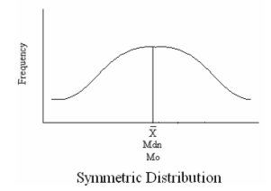
Symmetric Distribution
-Mode = Median = Mean

Slide 19
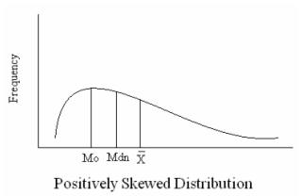
Positively Skewed Distribution
Typically, Mode < Median < Mean

Slide 20
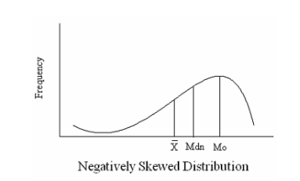
Negatively Skewed Distribution
Typically, Mode > Median > Mean

Slide 21
In-Class Exercise 1
The following three columns make up a single distribution of scores that were obtained by 18 students on a test. Compute the mean, median, and mode of this distribution of scores.
2 11 16
5 11 16
7 12 18
9 14 19
9 14 22
9 14 24

Slide 22
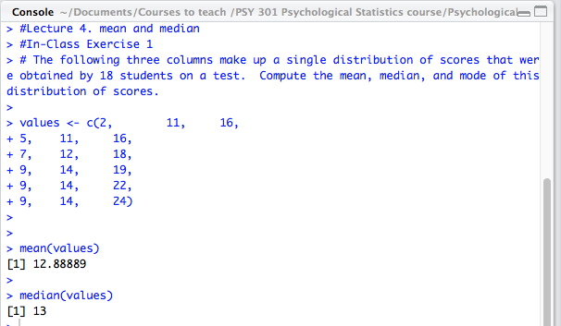
Solution for In-Class Exercise 1

Slide 23
In-Class Exercise 2
For the set of raw score values (X) shown below, compute the mean.
{ -9, 5, 7, -6, 0, 3, -2, 1, -4, -5 }
1. Using the mean you calculated above, evaluate the following expression for this set of numbers (the sum of the squared deviations about the mean):
2. Now, add 1 to the mean and evaluate the following expression (the sum of the squared deviations about the mean-plus-1):
3. Subtract 1 from the mean and evaluate the following expression (the sum of the squared deviations about the mean-minus-1):
4. Of the three values you computed in parts 1, 2, and 3 above, which was smallest?

Slide 24
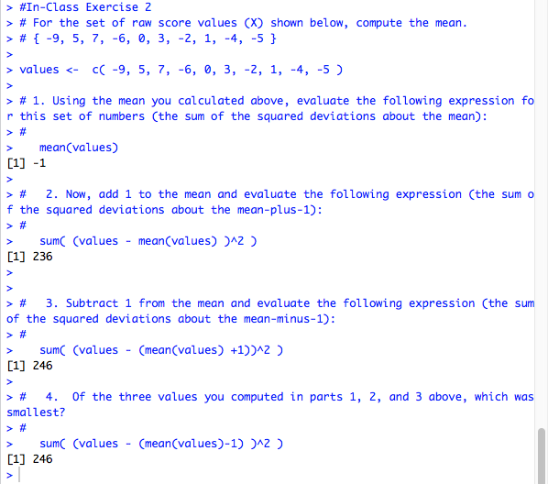
In-Class Exercise 2

Slide 25
Normal Curve

Slide 26
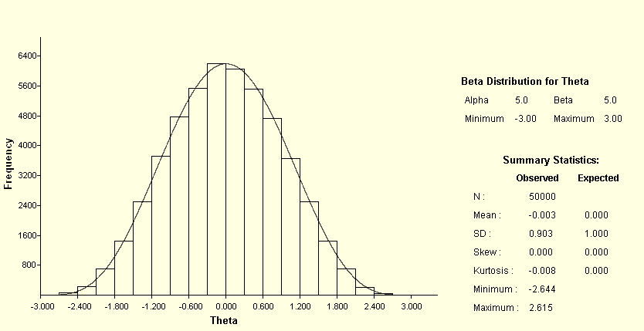
A Unique Symmetric Curve
Normal curve
Let’s say, if we have a distribution of test scores, and the test scores are normally distributed. That means the distribution of scores, if plotted on a graph, will form a normal curve, like above.

Slide 27
Normal curve
50% of the cases will be above the mean and 50% will be below the mean
The mean and standard deviation will define the total shape of the curve because the normal curve is precisely defined by a mathematical function.
In a normal curve with a small standard deviation, the curve will be fairly peaked in shape.

Slide 28
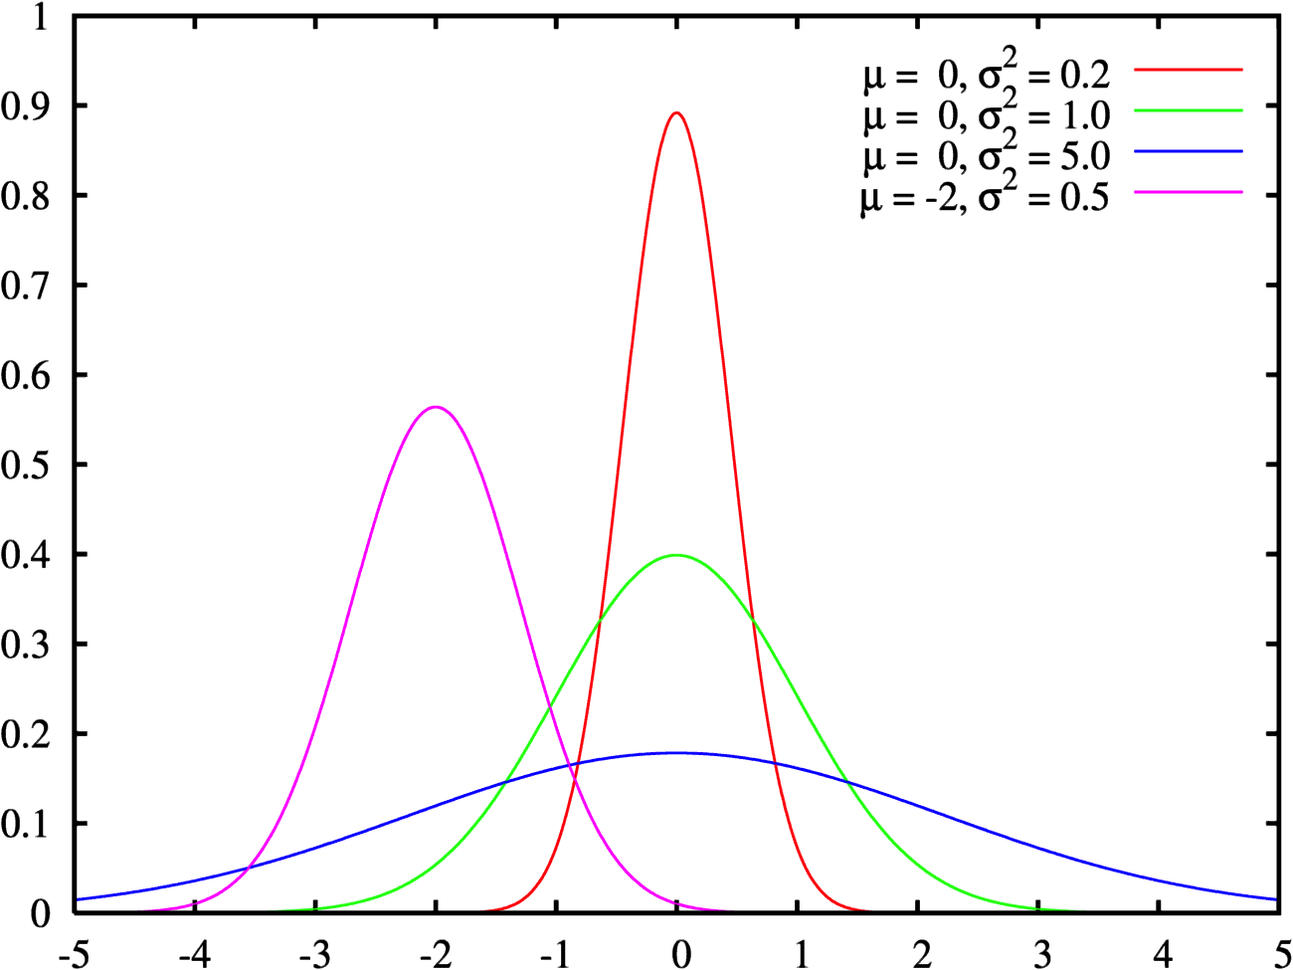
Standard Normal
Distribution
Notes:
STRETCHING/SQUISHING x-axis

Slide 29
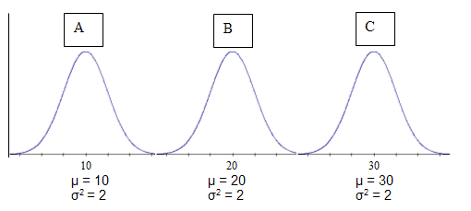
Mean and Variance of Normal Distributions
A, B and C are normal distributions with different means but the same variance

Slide 30
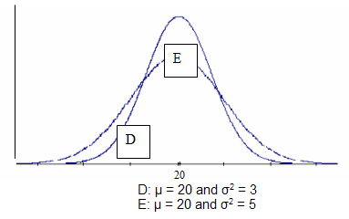
Mean and Variance of Normal Distributions
D and E are normal distributions with the same mean, but different variances

Slide 31
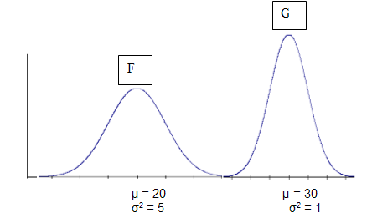
Mean and Variance of Normal Distributions
F and G are normal distributions with different means and variances

Slide 32
Areas of normal distribution
Learning Objectives
State the proportion of a normal distribution within 1 and within 2 standard deviations of the mean
Use the calculator "Calculate Area for a given X"
Use the calculator "Calculate X for a given Area"
Notes:
One standard deviation on either side of the mean of a normal curve will encompass approximately 68% of the area under the curve.

Slide 33
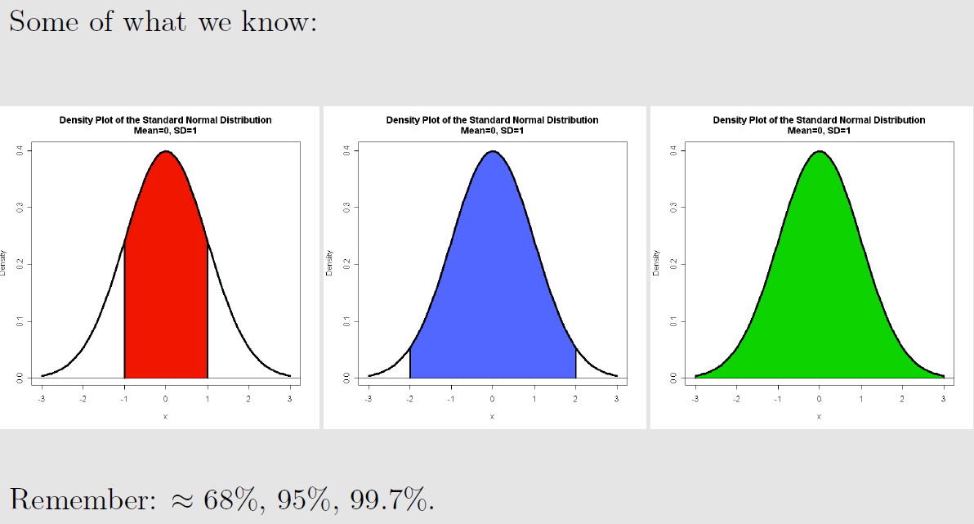
Areas of normal distribution
Notes:
One standard deviation on either side of the mean of a normal curve will encompass approximately 68% of the area under the curve.

Slide 34
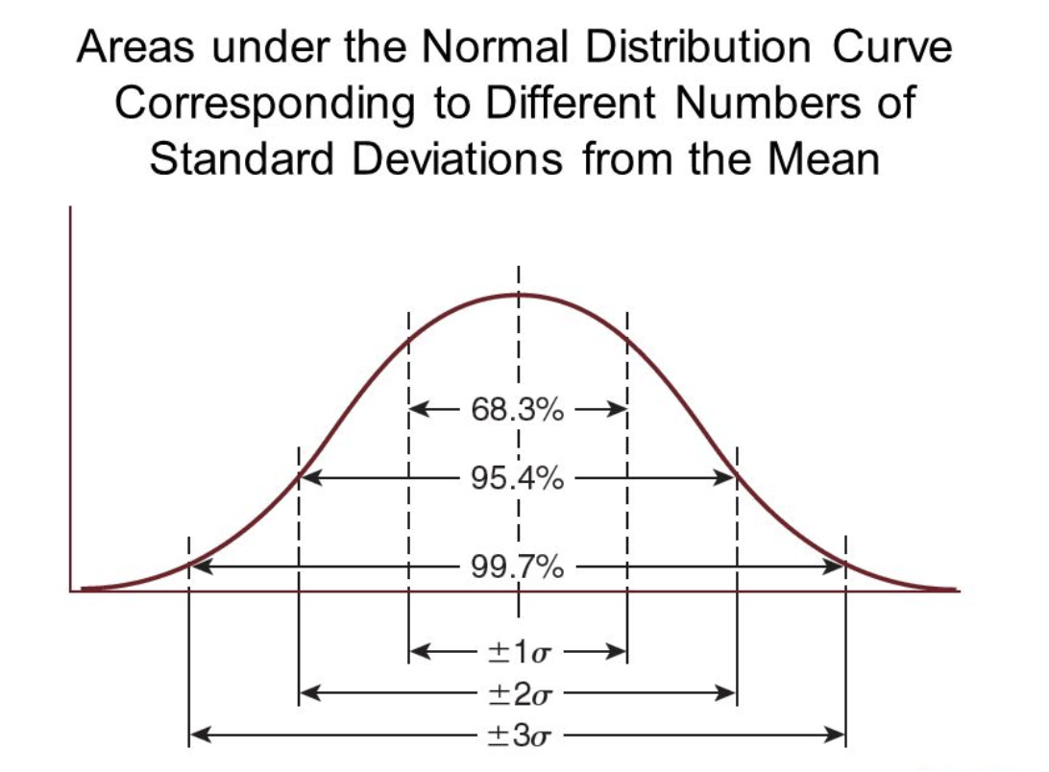
Areas of normal distribution
Notes:
One standard deviation on either side of the mean of a normal curve will encompass approximately 68% of the area under the curve.

Slide 35
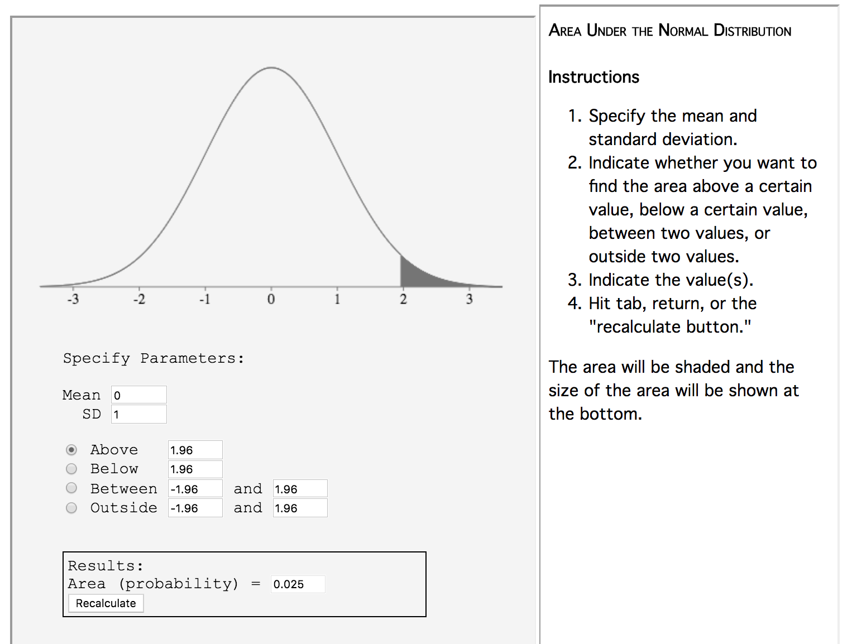
Areas of normal distribution
Normal Distribution Calculator
http://onlinestatbook.com/2/calculators/normal_dist.html
Notes:
One standard deviation on either side of the mean of a normal curve will encompass approximately 68% of the area under the curve.

Slide 36
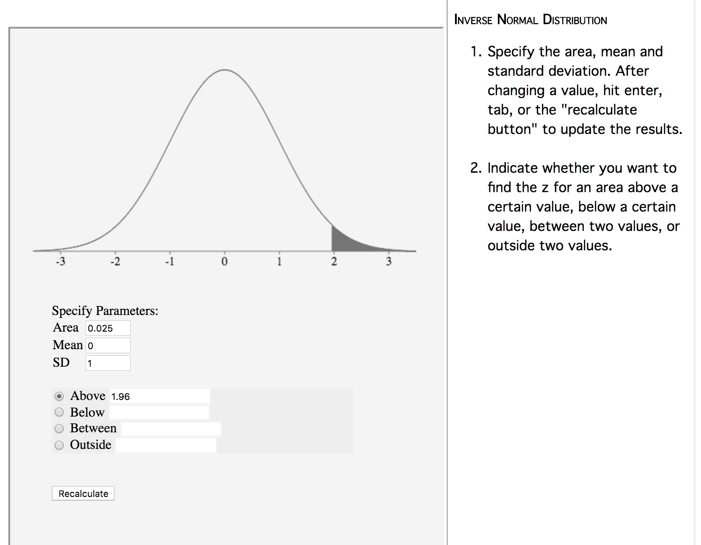
Areas of normal distribution
Inverse Normal Distribution Calculator
http://onlinestatbook.com/2/calculators/inverse_normal_dist.html
Notes:
One standard deviation on either side of the mean of a normal curve will encompass approximately 68% of the area under the curve.

Slide 37
1-2-3 Rule
Relating standard deviations to the area under the normal curve is so fundamental to statistical inference that statisticians often think of it as the 1-2-3 Rule.
The rule tells us the amount of area under the normal curve that is located between certain points (expressed in standard deviation units). Approximately 68% of the area is found between one standard deviation above and below the mean. Approximately 95% of the area is found to between two standard deviations above and below the mean. Approximately 99% of the area is found to between three standard deviations above and below the mean.

Slide 38
More about normal curve
Let’s say you know that some test results are normally distributed. You also know that you are one standard deviation above the mean.
Approximately what percentage of the test scores would be below/above yours?
Notes:
Now you know quite a bit about the normal curve

Slide 39
Linear Transformations and Standard Scores

Slide 40
Linear Transformations
In many situations, we want to take a set of original scores (X) and use them to create a set of new scores (Y)
Temperature example
This process is called SCORE TRANSFORMATION and is useful in creating a set of new scores that fall on a simpler or common numeric scale.

Slide 41
Linear Transformations
Linear transformation takes the form of
In a linear transformation shown above, a and b are constants. To create each new Y score, multiply each original X value by the constant b and then add to this result the constant a.

Slide 42
Linear Transformations
This leads to several questions:
How does compare to ?
How does standard deviation of Y compare to the standard deviation of X ?
How does the shape of the distribution of Y scores compare to the shape of the distribution of X scores?

Slide 43
Basic Rules
Basic rules for how the transformed scores (Y) relate to the original scores (X):
Note: The linear transformation does NOT change the shape of the distribution of scores.

Slide 44
Standard Scores—Z scores
Standard scores are a special subclass of linearly transformed scores for which the mean and standard deviation are fixed.
The idea behind Z score transformation is to linearly transform our original scores to obtain new scores (called Z’s rather than Y’s) that have a mean of 0 and a standard deviation of 1.
Z scores explains “how far away a score is from the mean in standard deviation units?”
It makes it possible to compare scores or measurements from different kinds of distributions.

Slide 45
Z-score: Standardization
If you determine the difference between an individual score and the mean of a distribution, and then you divide the difference by the standard deviation of the distribution, then you get the so-called “z-score”.
The distance the score is from the mean, expressed in standard deviation units.
Notes:
Show why this is a linear transformation

Slide 46
Formula for converting z scores to raw scores
(population)
(sample)

Slide 47
Properties of Z Scores
1. Z scores always have a mean of 0 and a standard deviation of 1
2. Z scores carry with them two pieces of information:
-The magnitude of a z score is the number of standard deviations between its raw score and the
mean
-The sign of a z score (+ or –) indicates the direction of the corresponding raw score relative to the mean

Slide 48
Properties of Z Scores
3. Z scores state the position of an original score in relation to the mean of the distribution, using S_{X} as the unit of measurement (i.e., the number of standard deviations that a score is from its mean)
4. Transforming raw scores to Z scores does not change the shape of the distribution of scores
5. Z scores make it possible to compare raw scores that have different units of measurement: The conversion of a set of scores to z scores results in a unitless set of values
Notes:
Two scores that are the same number of standard deviations above (or below) the mean in their respective distributions will have the same z score

Slide 49
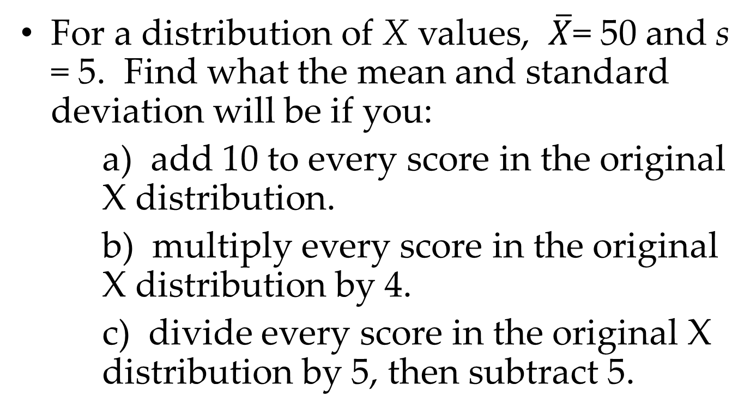
Example/Exercise
For a distribution of X values, $\overline{X}$= 50 and s = 5. Find what the mean and standard deviation will be if you:
a) add 10 to every score in the original X distribution.
b) multiply every score in the original X distribution by 4.
c) divide every score in the original X distribution by 5, then subtract 5.

Slide 50
Why do we care about Z-score?
Because now we can compare the relative standing of two students, no matter whether the test is measured on 100-points, or 250-points.
Suppose we have two students, Mikey (score=84, mean=74), and Billy (score=61, mean=51). Both of the standard deviations are 10. What are the Z-scores for each of them?

Slide 51
A special Curve—normal curve
Frequency distribution of Z-scores is the “standard” normal curve.
Z-score, therefore, is a point along the baseline of the normal curve.

Slide 52
Table of Areas Under the Normal Curve
This table expands our knowledge from 1-2-3 rule.
What about the areas under the curve that fall, let’s say, between the mean and 1.25 standard deviations above the mean?

Slide 53
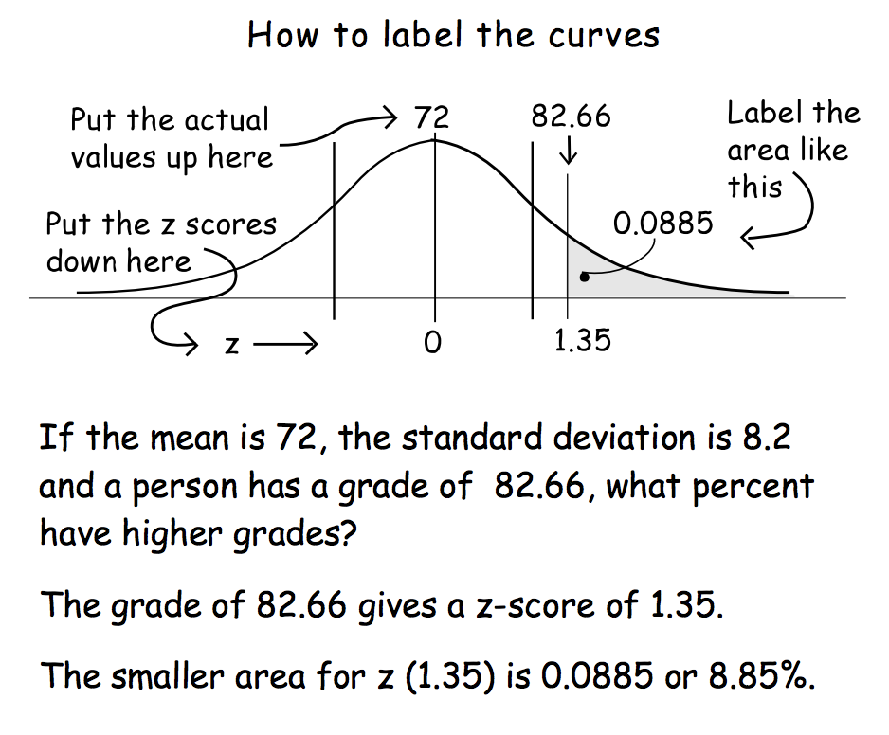
Table of Areas Under the Normal Curve

Slide 54
probability Q and Z score
Calculate probability Q from z
Calculate z from probability Q
https://www.fourmilab.ch/rpkp/experiments/analysis/zCalc.html

Slide 55
probability Q and Z score
Calculate probability Q from z using R code
pnorm(1.35) = 0.911492
1-pnorm(1.35) = 0.08850799 http://stats.seandolinar.com/calculating-z-scores-with-r/

Slide 56
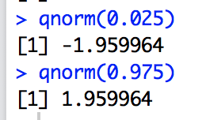
probability Q and Z score
Calculate z from probability Q using R code
qnorm(0.025)
-1.959964
qnorm(0.975)
1.959964
http://www.stat.umn.edu/geyer/old/5101/rlook.html

Slide 57
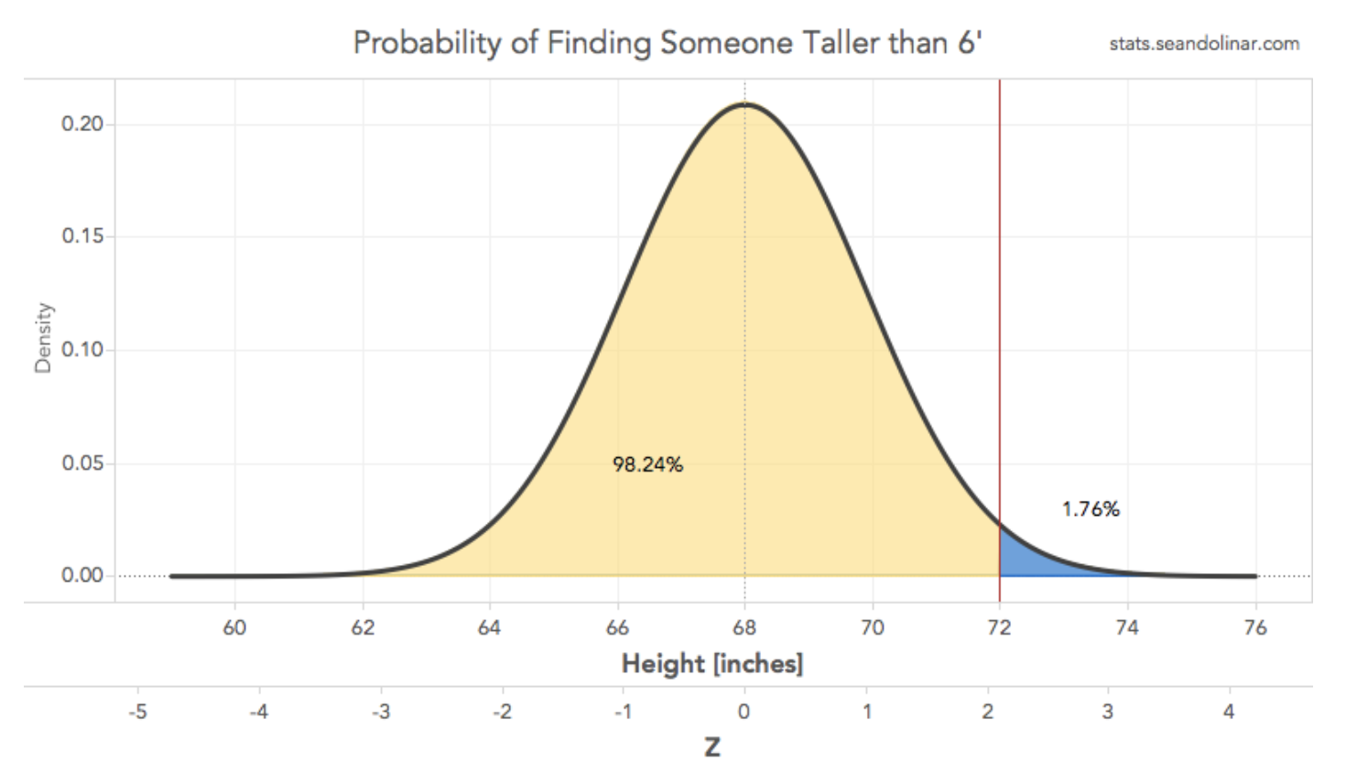
probability Q and Z score
Calculate probability Q from z using R code
http://stats.seandolinar.com/calculating-z-scores-with-r/

Slide 58
In-class exercise
In a normal distribution with µ = 100 and σ = 10, what proportion of scores fall between each of the following pairs of scores?
90 – 110
85 – 112

Slide 59
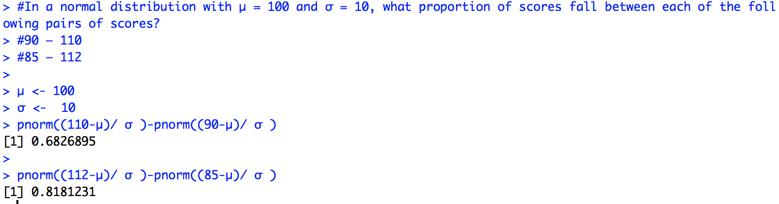
In-class exercise

